Slide 1
Result of Streamline Predict Network
研究生：廖惠淳
指導教授：李同益

Slide 2



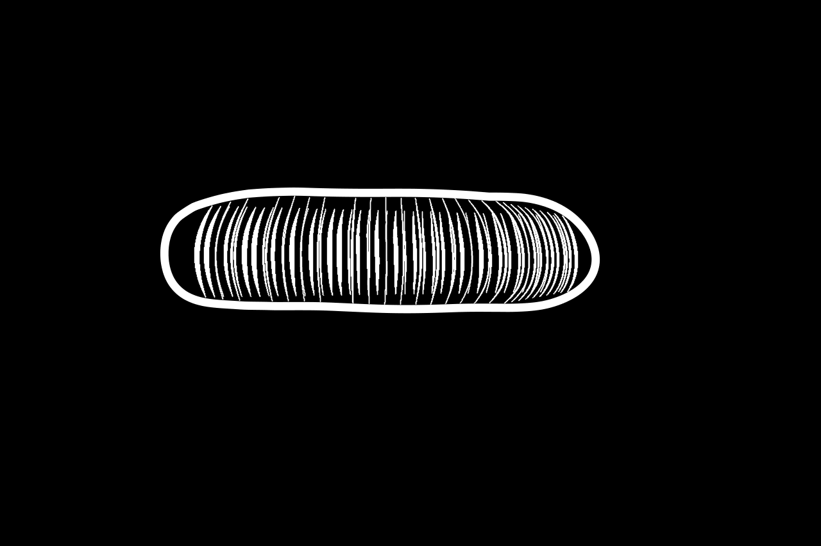


Result Comparison – torus
Total frame : 48
Number of keyframe : 6
Number of segment : 1
Inference time : 44s
Ours feed forward Seed inherent
w/o hand-fixed SCR with hand-fixed SCR time-vary tensor
Notes:
我們的結果只輸入一張渲染圖與輪廓圖
其他皆為所有關鍵幀皆渲染

Slide 3




Result Comparison – H
Total frame : 48
Number of keyframe : 6
Number of segment : 3
Inference time : 58s
Ours Seed inherent
with hand-fixed SCR time-vary tensor

Slide 4



Result Comparison – Girl
Total frame : 42
Number of keyframe : 5
Number of segment : 10
Inference time : 123s
Ours with hand-fixed SCR time-vary tensor

Slide 5

Others Results
Total frame : 72
Number of keyframe : 10
Number of segment : 10
Inference time : 272s
This example is longer, we can observe error will accumulate.

